Slide 1
WELFARE AND HEALTH SECTOR
TRAMITS

Slide 2
Welfare and Health Sector
2020-2021
@SOM_Mataró

Slide 3
The Idea
Part One
Ramón, who coordinates the neighbourhood association, is having an increasingly hard time managing his association’s grant applications and paperwork online. He has started working with “TRAMITS” so they can give him a hand.

Slide 4
Development
Need We have detected a need for help with online paperwork (through support for management or answers to queries), grant applications or formalities involving public administrations among associations receiving support.
For part of the public, adapting to technological changes is proving difficult. This is particularly true for the elderly and for those with limited resources.
Of people aged 55-74 in Catalonia, only 62% use the internet, especially to search for information on goods and services. (1)
From 2006 to 2019, the percentage of homes with computers in Catalonia rose from 61.6% to 85%. (2)
Who needs this? 3 GROUPS
This service is aimed primarily at:
Elderly individuals who lead associations and need to work with public administrations to process grants,
Elderly individuals who missed the tech boat and who need to complete formalities with public administrations or large service companies, and
Young people with limited resources who have a hard time accessing computers and completing formalities online.
Idea
“TRAMITS” wants to offer support services for online paperwork, grant applications or other formalities involving public administrations (A) and large service companies (B).
We can offer access to computers and training for young people who have a hard time accessing new technologies (C).
In exchange for the training offered to these young people (C), they can provide short-term support for the elderly (B) and cover some of their needs.
“TRAMITS” wants to become an intergenerational meeting point that strengthens community bonds.
Depending on the results of the needs assessment, “TRAMITS” is considering different scenarios for the scale of the project.
Source: Economia Silver a Catalunya|Informe Sectorial – April 2018
Source: Idescat, using Survey on ICT Equipment and Use in Households by INE. Notes: Equipment in homes with one or more members aged 16-74.

Slide 5
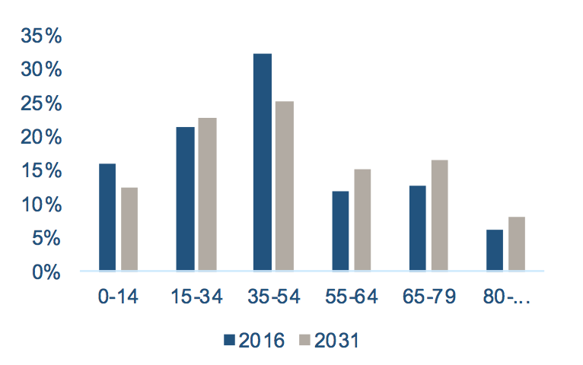
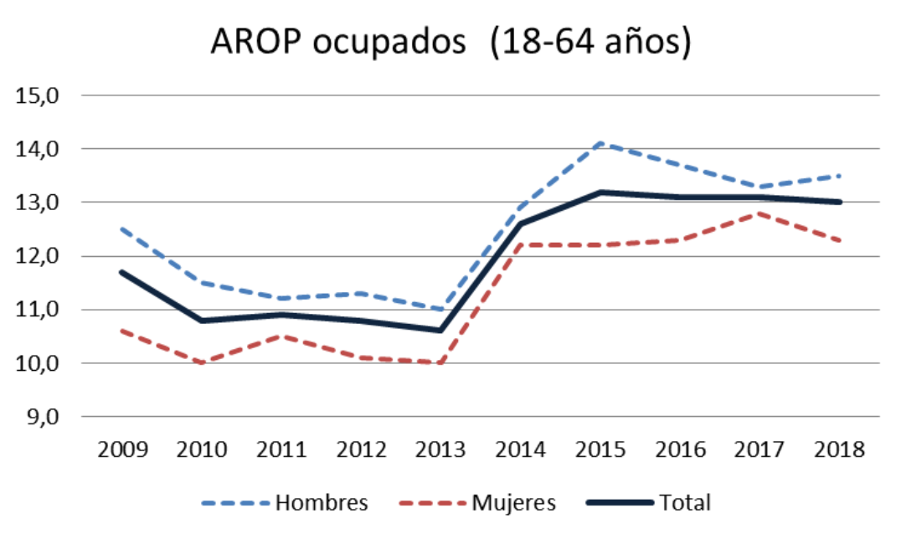
Trends
Trends in writing
Population growth and progressive ageing. Increasing numbers of elderly. More than 30% of Catalans will be over 65 in 2050 (1).
We have detected a paradigm shift that places the focus on the individual. More social and emotional proposals. Greater personalization of services. Opportunities for new ways of providing health and welfare services.
Care for individuals is starting to be the focus of political action.
Technology, health and welfare will overlap in all areas. New technologies can allow communities and individuals to organize new forms of innovation and collaborate with one another. Community innovations facilitate participation by grassroots actors such as social movements, academic networks, activists or professionals who experiment with alternate ways of creating knowledge and innovation (2).
Digital Transformation. Drives change while also generating tension. Companies and the administration are transferring a rising number of “activities” to the end user over the internet.
A rise in inequality will strain social protection systems and will require greater effort in the field of social innovation.
By nationality, the risk of poverty or social exclusion is 47.7% for those born in the EU and 56% for others, as compared to 23.1% for those born in Spain. (3)
Environmental changes will increase the influx of immigrants, generating both a linguistic/cultural and a technological need.
Trends in graphs
Evolution of the Distribution of the population of Catalonia (1)
% of population
Age
Evolution of workers facing poverty or risk of exclusion in Spain (3)
Men
Women
Total
Source: Economia Silver a Catalunya|Informe Sectorial – April 2018
Source: United Nations. Economic and Social Council. Commission on Science and Technology for Development. The impact of rapid technological change on sustainable development. E/CN.16/2019/2
Source: Evolución de la pobreza en España. 2009-2018. Principales Indicadores. Government of Spain. Ministry of Health, Consumer Affairs and Social Welfare

Slide 6
Conceptualization of the idea
What? “TRAMITS” wants to be an intergenerational gathering place providing support for all sorts of online formalities.
The idea is to combine the needs of three different groups and take advantage of the potential for collaboration among them.
Depending on the results of the needs assessment, “TRAMITS” is considering different phases or levels for the project:
Phase 1: Give support to the elderly in all sorts of online formalities.
Phase 2: Give support to individuals leading existing associations in the process of applying for grants.
Phase 3: Provide access to computers and training for young people with limited resources so they can then provide support to elderly individuals.
(Potential) differential values of “TRAMITS” (to be validated along with the segments):
The social and cooperative value of the project.
Specialization in online formalities.
Multicultural, multi-language space.
How?
“TRAMITS” is meant to be an online project with a physical space for training, support and community building.
During the validation, we will study the connections between the needs of the 3 recipient groups.
In all scenarios (without considering prototypes), the project will require a strong investment in knowledge and resources in order to learn about the grants the associations are applying for, as well as the main online formalities demanded by service companies.
Some key indicators for “TRAMITS” are:
CAC (client acquisition cost).
Take rate (commission) in the case of work with third parties. Rentability vs. friction.
Avg. operation/service (average value of each “operation”).
Avg. fill time (average time needed to fulfil demand)
Recommendation.
For whom?
The sub-segments we choose to emphasize will depend on the needs evaluation. This will depend on the urgency of the need, the type of solution required and the resources needed to fulfil it.
ELDERLY INDIVIDUALS who lead ASSOCIATIONS and need to apply for grants from the public administration.
ELDERLY INDIVIDUALS WHO HAVE MISSED THE BOAT ON TECHNOLOGY and who need to complete formalities with the public administration and large service companies.
YOUNG PEOPLE WITH LIMITED RESOURCES who have a hard time accessing computers and completing online formalities.

Slide 7
Simplified layout of the business model
Key alliances
Public-private partnerships, associations and organizations that work for and with elderly people and young people with limited resources
Companies that provide
care for the elderly
Day centres and civic
centres
Specialists/ the Administration
Opcions platform or similar entities
Key activities
Marketing and community building
Creating ties with associations
Designing circuits, protocols and processes (grants and formalities)
Training youth
Value proposal
Support services for applying for grants and completing online formalities with the administration.
Support services for all sorts of online processes (with the administration or private companies).
Free use of computers in exchange for hours of support for the elderly.
Transversal value proposal: Online, personalized, multilingual support services.
Relationship with clients
Building community
Trust management and customer support will be very important
Building customer and user loyalty
Customer segments
Elderly individuals who have a hard time completing online formalities
Small associations whose leaders have a hard time adapting to new technology
Young people without computers who are eager to learn and participate in this sort of project
☑
☑
☑
☑
☑
☑
☑
☑
Key resources
3-4 roles (community building + design processes + global vision + training capacities)
Website
Web server and email, 2-3 computers and telephones
Knowledge on grants and bureaucratic processes
Young educators
Multilingual youth
☑
Channels
Logistics: warehouse + delivery
Website/platform bringing together producers and products
☑
Cost structure
Wages (monthly) = €4,000 (€1,500 + 500 (Social Security-* 2)
Website = €3,000 (initial: name, brand, hosting design)
Computers = (€700 per computer)
Communication = €300-€900
Community space = Rented or free use.
Furniture for community space.
Tax management (€150 a month).
Revenue model
Sale of services to small associations (2-3% of grant).
Membership fees for the elderly (€30 a year).
Donations and grants—space and computers (administration and private organizations)
Young people–exchange (use of computers in exchange for assistance for the elderly)
☑
☑
☑
Dependent on the validation of needs
Dependent on the validation of service/solution
Conceptualization of the idea

Slide 8
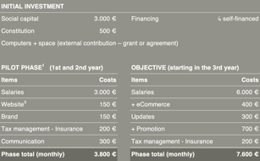
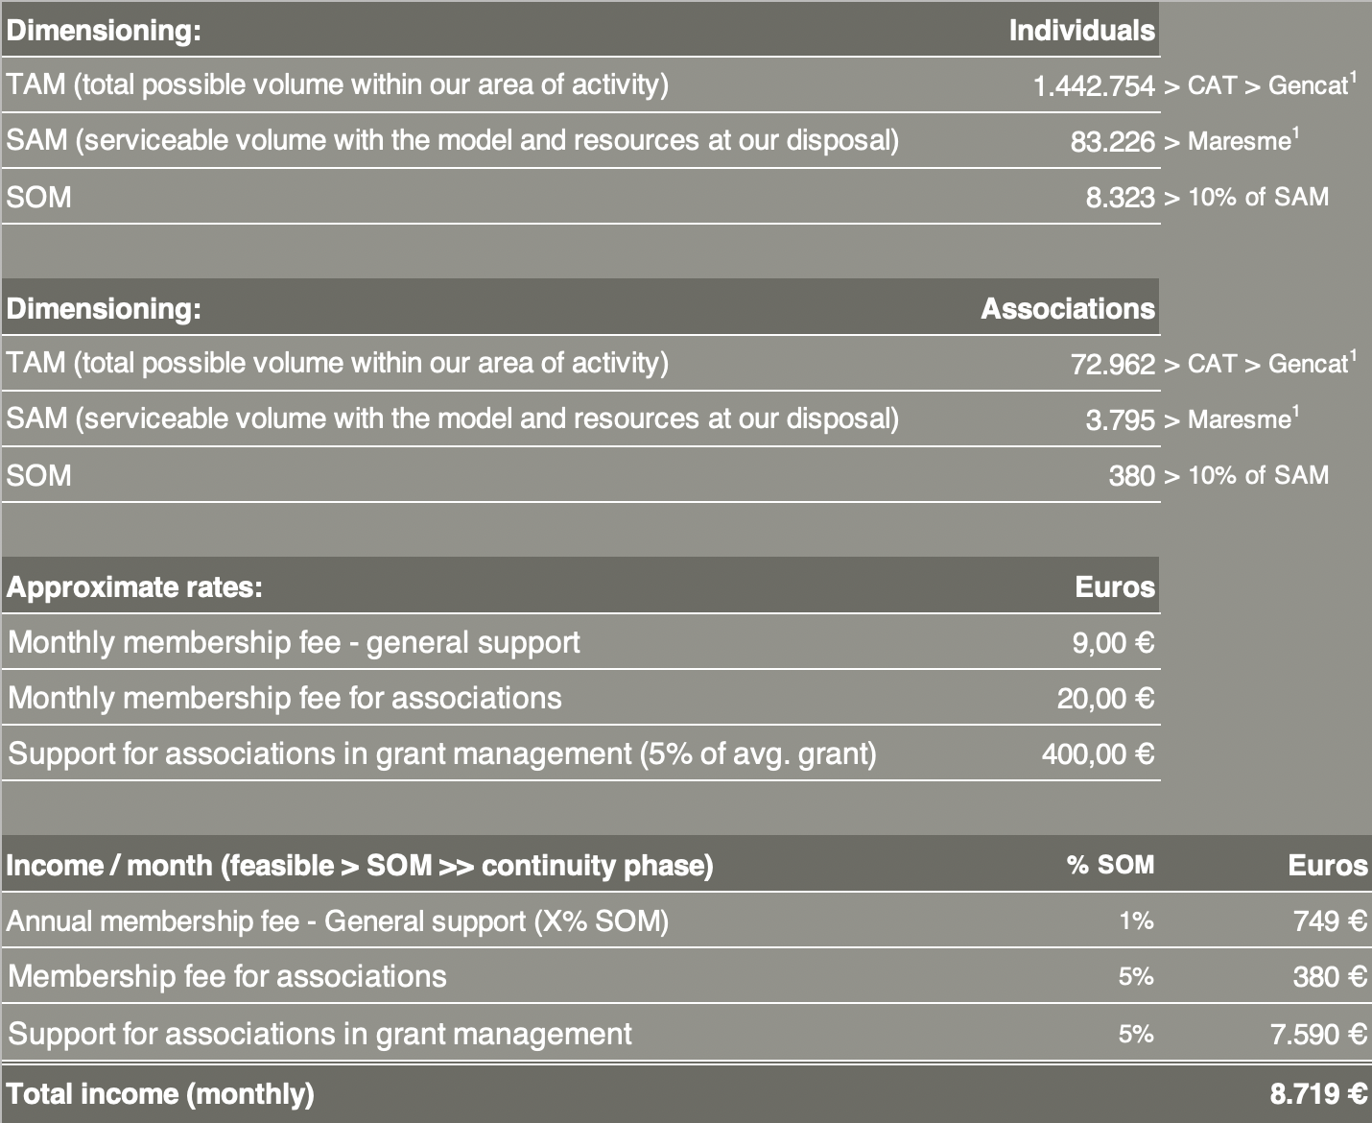
Pre-feasibility of the idea
Cost structure (key activities, key resources, key alliances and channels)
In the pilot phase, we will consider the cost of living + minimum costs for communicating the phase. For this phase, we are expecting significant self-financing from the initiators.
In both phases we will attempt to negotiate that the website, brand, communication, eCommerce, etc. be paid using a flat rate to minimize initial investments and to make as effective a use of funds as possible.
Additional offers will be included in the continuity phase.
Revenue model (market sizing and fees for services)
Idescat – Statistical Institute of Catalonia – Government of Catalonia

Slide 9
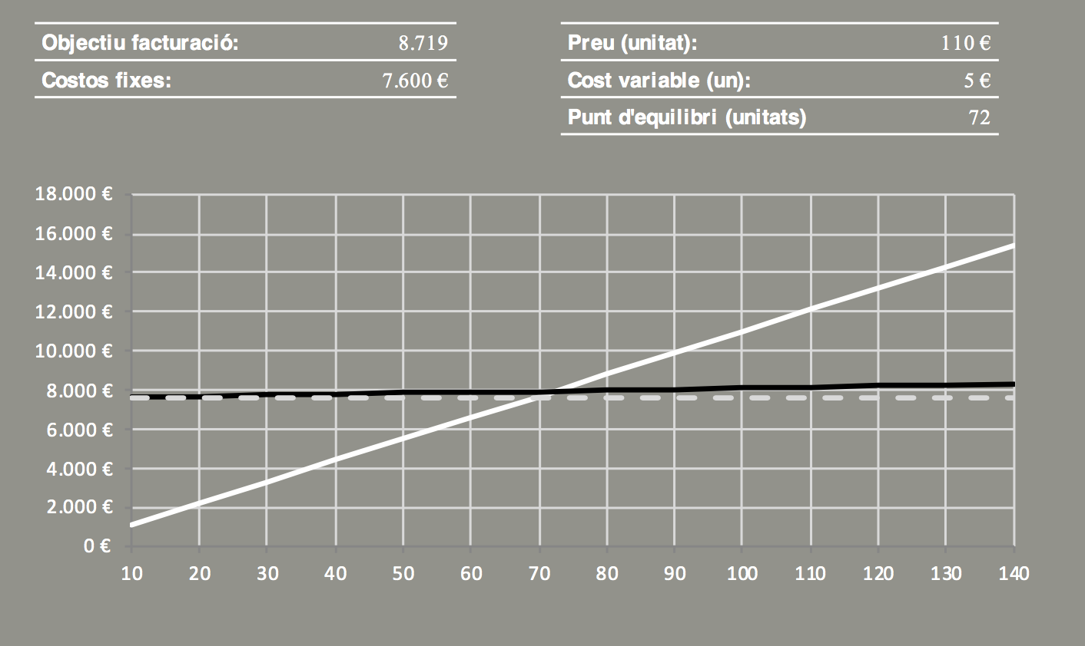
Point of balance (monthly)
Scenario for the point of balance under the following conditions:
Membership fees from the elderly and associations.
Planned unit fee: €110
10 user members
1 association partner
We will calculate the point of balance to determine how many product or service units need to be sold in order to cover costs and see if this volume of units is feasible with the resources at our disposal. The formula for calculating the point of balance is:
PE = CF / (PVunit - CVunit)
Escenari de punt d’equilibri en les següents condicions
Quota de socis, de gent gran i associacions
Preu “unitat” considerat 110 €
10 socis usuaris
1 soci associació
Expenses
Revenue from sales
Fixed monthly expenses
Pre-feasibility of the idea

Slide 10
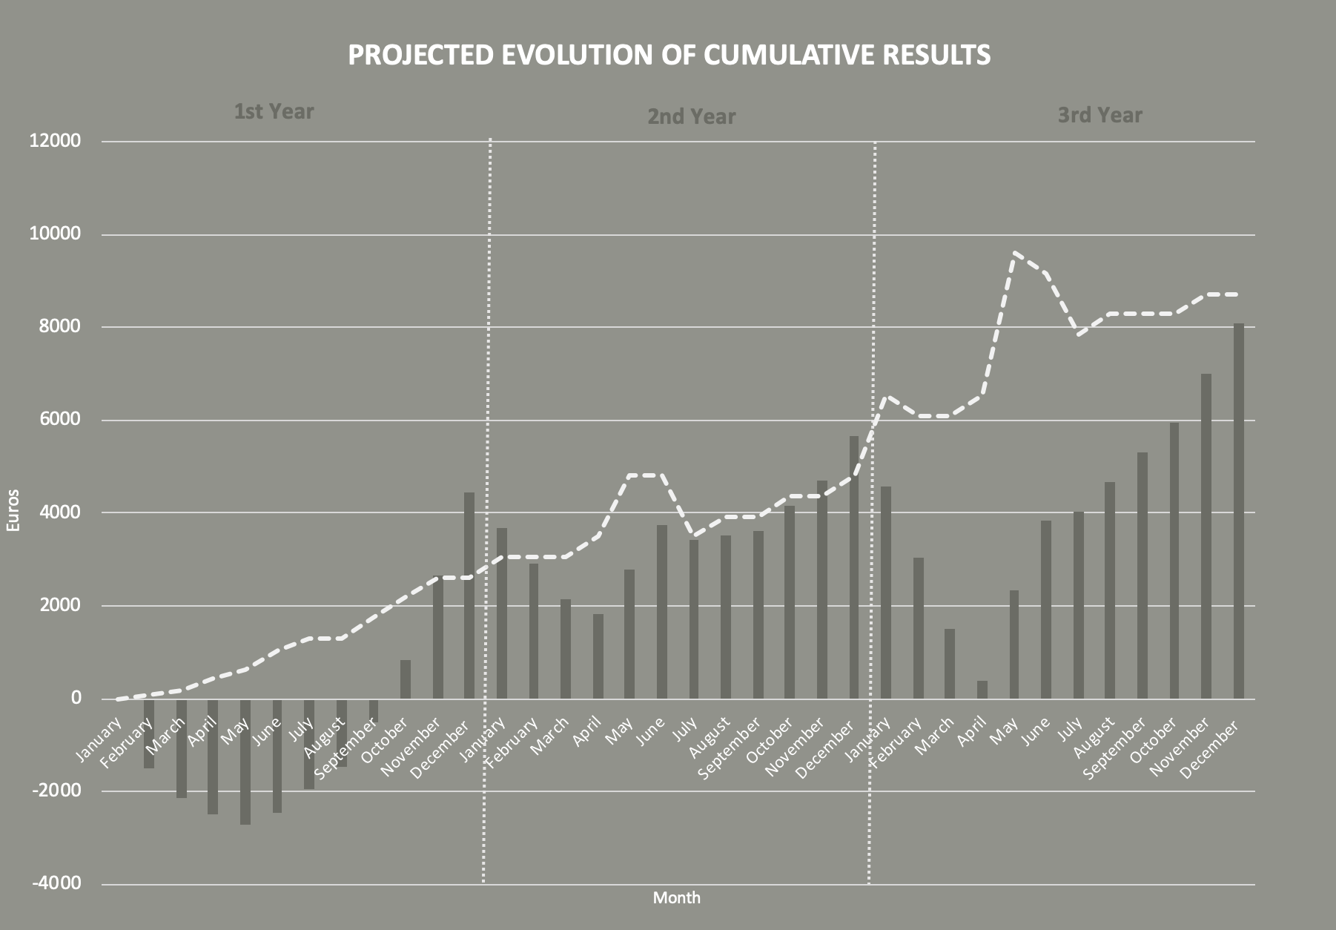
Scenario for reaching viability
Planned scenario:
The first year, no advanced payments (salaries) for founding members. The goal is to establish the project and get it up and running.
The second year, the goal is to reach the point of balance with a minimal payment (50% of planned final payment).
The third year, the goal is to reach viability. All expenses should be covered regularly. The project is viable..
We have projected sales and costs in keeping with the calendar for grant applications.
The formula for calculating the projection is:
The first year, 0-15% of the sales target.
The second year, 30-45% of the sales target.
The third year, we will reach 100% of the sales target.
Escenari plantejat:
Primer any sense Bestretes (Salaris) pels socis fundadors, l’objectiu es constituir-se i començar a engegar el projecte.
Segon any, l’objectiu és arribar al punt d’equilibri, amb una bestreta mínima (50 % Bestreta objectiu)
Tercer any, objectiu arribar a la viabilitat. Totes les despeses estan cobertes regularment. El projecte es Viable.
Fem un projecció de vendes i despeses ajustada al calendari de presentacions de subvencions.
La fórmula per calcular la projecció és:
Primer any, entre el 0% i 15 % vendes objectiu.
Segon any, entre el 30 i 45 % vendes objectiu.
Tercer any, arribem al 100 % vendes objectiu
Monthly income
Cumulative monthly results
Pre-feasibility of the idea

Slide 11
Validation
Part Two

Slide 12
Validate needs with those that have them
Phase description: in all new products, before designing a possible solution for the detected need, it is a good idea to validate the needs themselves with those that have them. Therefore, in this phase, we need to (a) list the needs we think need to be addressed, and (b) check those needs with the people we believe have them.
Hypothesis of needs:
Segment of end users—associations:
Final users have an increasingly hard time applying for the grants they need to survive.
These users are willing to pay for a service that helps them apply for grants.
Segment of end users—the elderly:
Final users have an increasingly hard time completing online formalities with the administration and with service companies.
These users are willing to pay for a service that helps them with online formalities in exchange for a monthly fee.
Segment of end users—young people:
Young people in need of computers would be willing to exchange access to computers and working space for volunteer hours.
Actions or strategies:
☐ Empathy exercise (focus on need):
In empathy exercises, we “put ourselves in the shoes” of the end users. We live their experiences first-hand in order to better understand their needs.
☐ Stroll through online forums
This “stroll” through online forums can help us validate or even discover customer needs.
☑ Interviews with individual clients
The goal of these interviews is to validate each of the needs of the end users (list of hypothetical needs).
Review the list of hypothetical needs with each interviewee. 10-15 interviews.
☑ Agent interviews
These fulfil the same purpose as the interviews with customers. However, in this case, they involve end users of the service or product.
Review the list of hypothetical needs with each interviewee. 10-15 interviews.

Slide 13
Validation of product or service/solution
Phase description: in all new products, before designing a possible solution for the detected need, it is a good idea to validate the needs themselves with those that have them. Therefore, in this phase, we need to (a) list the needs we think need to be addressed, and (b) check those needs with the people we believe have them.
Product hypothesis:
Segment of end users—associations:
End users are interested in hiring a support service for processing grant applications.
Segment of end users—the elderly:
End users are interested in hiring a service to help them with online formalities, either via telephone or by visiting the cooperative.
Segment of end users—young people:
Young people in need of computers would be willing to exchange access to computers and working space for volunteer hours.
Actions or strategies:
☑ Solution interviews
Solution interviews are an opportunity to validate the intended purposes of the service or product (list of functionalities) with the end users..
1-on-1 interviews on functionalities with potential users, together with an online or physical prototype.
☑ Solution interviews with agents
These serve the same purpose as customer interviews. However, in this case, the interviews are with the agents that interact with the final users of the service or product.
1-on-1 and group interviews with agents on functionalities for potential clients, together with an online or physical prototype.
☐ Online prototype
Online prototypes allow us to show the service or product to the customer. The objective is not to have a finished product, but to show customers some basic functionalities to get an idea of their impression and possible suggestions for improvement.
Mock-up of the website (layout and functionalities)
Web template with ecommerce and catalogue functionalities
☐ Physical prototype
Physical prototypes allow us to show the service or product to the customer. The objective is not to have a finished product, but to show customers some basic functionalities and get an idea of their impression and possible suggestions for improvement.
Brand mock-up
Flyer/catalogue

Slide 14
Validation of numbers
Phase description: in all new products, before designing a possible solution for the detected need, it is a good idea to validate the needs themselves with those that have them. Therefore, in this phase, we need to (a) list the needs we think need to be addressed, and (b) check those needs with the people we believe have them.
Validation of numbers
Internal dimension
We will review the principal fixed and variable costs for the product.
We will confirm the margins applied to the products or services offered by analysing those used in the sector.
We will ensure that the price of our products and services cover costs related to creation, production, assembly and commercialization.
External dimension
We will confirm our costs based on customers’ perceptions and, in particular, on direct and similar competition from the sector.
Actions or strategies:
Internal dimension
☑ Review of fixed costs, variables We will review fixed costs using information from the sector’s main agents. We can also download economic-financial reports (for example, this balance sheet) from companies from the sector that could provide additional details on costs and margins.
☑ Review of prices In this case, we will use a price analysis based on a collection of our fixed costs, variables and the margins of our products or services.
External dimension:
☑ Comparative table of related entities This comparative table will help us to collect and analyse the prices charged by the competition (direct or similar), to distinguish between those with high, medium and low prices, and to determine average fees in the market. This tool can also help us to collect and analyse other aspects of the competition such as the communication they use (brand, language, tone, etc.), the contact channels they use, etc.
☑ Customer perception It is also a good idea to see the perceptions our potential customers have of our products and services.
Interviews with potential users of our services using the data obtained from the comparison with the competition in order to gauge their impression.

Slide 15
Thanks!
Socialneet@ajmataro.cat
wwww.mataró.cat/socialneet
@SOM_Mataró

Slide 16
WELFARE AND HEALTH SECTOR
TRAMITS
Socialneet@ajmataro.cat
wwww.mataró.cat/socialneet
@SOM_Mataró

